Slide 1
Problem Statement :
Text to image generation
Team Members
Chaitanya Undale
Vaibhav Chavhan
Objectives
Text Understanding and Context Extraction
Image generation related to context
Model improvement for better image generation
To design UI for users to generate image
To enable image generation from multiple language text
Benefits and Impact
Anyone without skills can generate images
Reduces the time and resources required for manual image creation.
specific and personalized visual content generation.
Generate images for social media posts, articles, and other forms of digital content.
Dataset Link : Link
Dataset Details : 7000+ rows with prompts and images

Slide 2
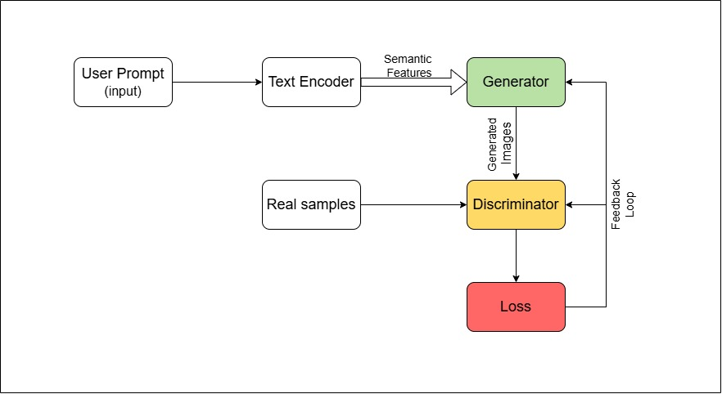
Idea Details
The project focuses on developing a text-to-image generation system that leverages the power of generative artificial intelligence (GenAI) and natural language processing (NLP). By utilizing advanced models such as transformers for text encoding and sophisticated generative networks like GANs or diffusion models for image creation, the system aims to transform textual descriptions into visually appealing images.
The architecture incorporates a feedback loop to refine the model based on user interactions and generated outputs, ensuring continuous improvement in image quality and relevance. This innovative approach not only enhances creativity and artistic expression but also has potential applications in fields such as advertising, content creation.
Figure 2: Architecture Diagram

Slide 3
Literature Survey
Survey on Methodologies
Survey on Gaps
“Enhancing Image-to-Text Generation in Radiology Reports through Cross-modal Multi-Task Learning”( Nurbanu Aksoy et al., 2024)-A multi-task learning framework integrates chest X-ray images with various data types to generate radiology reports, improving language generation by bridging the visual-textual semantic gap.
"Evaluating Text-to-Visual Generation with Image-to-Text Generation"(Zhiqiu Lin et al., 2024)- An automatic approach using VQAScore benchmarks text-to-visual generation by assessing alignment between images and complex textual descriptions.
"Text-to-Image Generation Using Deep Learning"(Sadia Ramzan et al., 2022)- This paper explores the use of RC-GAN to convert textual descriptions into visual representations by bridging advancements in text and image modeling.
"Controllable Text-to-Image Generation"(Bowen Li)- ControlGAN is a generative adversarial network that generates high-quality images from text with enhanced controllability.
Survey on Datasets
Survey on results
GAN-Based Models (e.g., AttnGAN, StackGAN):
Perform well in generating simple scenes but struggle with complex, multi-object scenarios.
Diffusion Models (e.g., DALL·E 2, Imagen):
Achieve state-of-the-art realism and text alignment, excelling in intricate scene generation.
Transformer-Based Models:
Provide scalability and improved coherence for longer text prompts.
COCO (Common Objects in Context):
Focused on real-world images with dense captions, commonly used for general-purpose text-to-image tasks.
Visual Genome:
Provides rich annotations, supporting context understanding for complex scene generation.
Oxford-102 Flowers & CUB-200 Birds:
Domain-specific datasets ideal for fine-grained image synthesis.

Slide 4






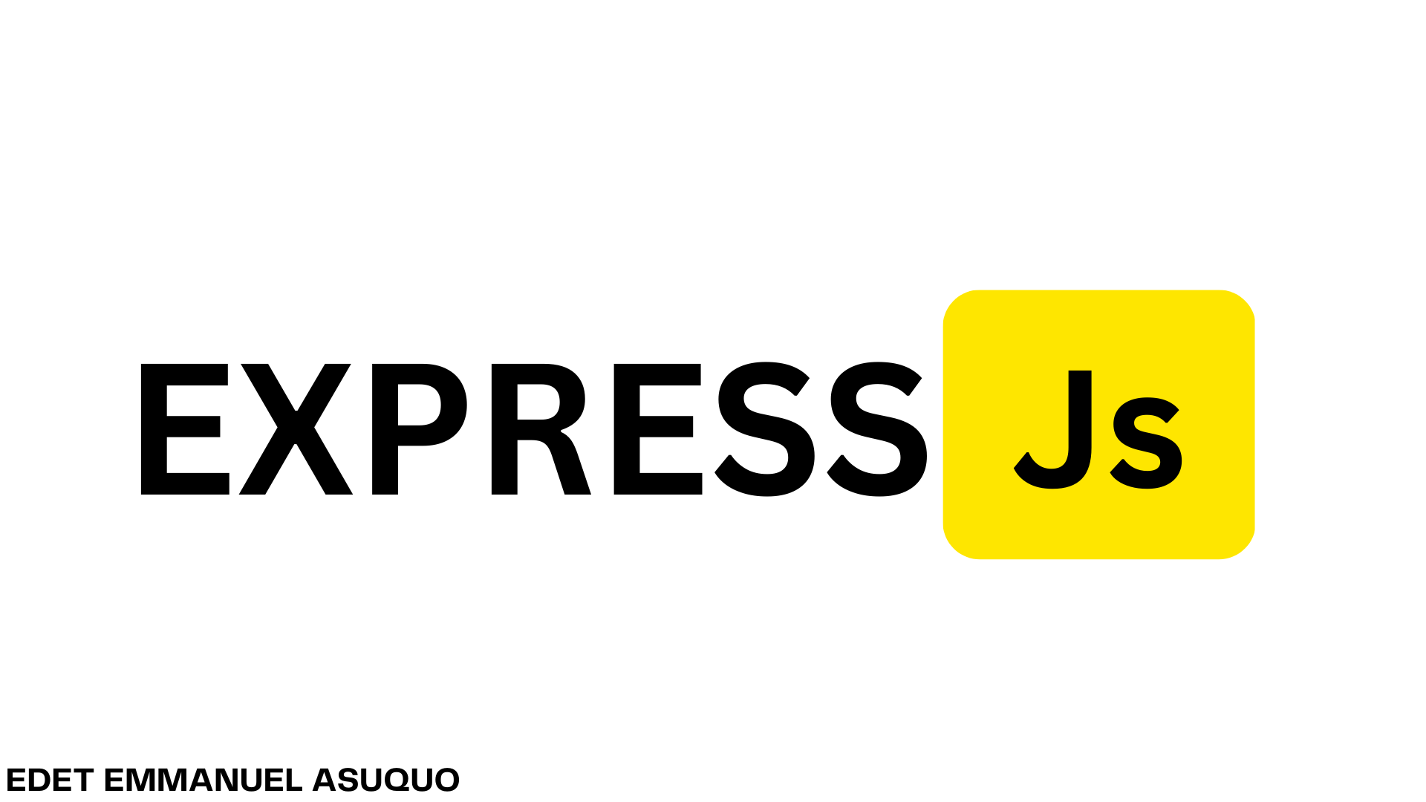

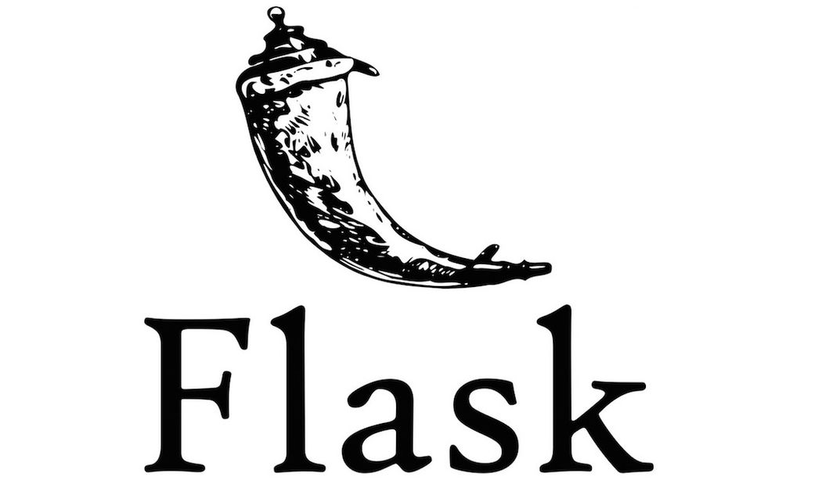


Approach Details
Innovativeness
Multimodal Learning
Semantic Understanding of Prompts
Continuous Improvement through Feedback
Multi-Lingual Support
Frontend
Backend
Conclusion
Innovative Solution: The project demonstrates the powerful synergy of generative AI and NLP, offering a cutting-edge tool for transforming text into high-quality images.
Versatile Applications: The project caters to diverse domains like marketing, education, entertainment, and design, showcasing its wide-ranging potential.
Figure 3: Tech Stack

